Slide 1
Employee Data Analysis using Excel
STUDENT NAME: S.SHREE LAXMI
REGISTER NO: 122204053 asunm1659122204053
DEPARTMENT: CORPORATE SECRETARYSHIP
COLLEGE: SHRI KRISHNASWAMY COLLEGE FOR WOMEN

Slide 2
PROJECT TITLE
Employee Gender Analysis using Excel

Slide 3


AGENDA
Problem Statement
Project Overview
End Users
Our Solution and Proposition
Dataset Description
Modelling Approach
Results and Discussion
Conclusion
3/21/2024 Annual Review

Slide 4

PROBLEM STATEMENT
A well-crafted problem statement for gender analysis should:
Identify a specific issue or gap
2. Recognize the gendered dimensions of the issue
3. Suggest potential consequences or impacts
4. Imply a need for change or intervention
This problem statement serves as a starting point for investigation, analysis, and potential solutions to address gender-based inequalities.

Slide 5

PROJECT OVERVIEW
-Research and analysis of existing data and literature on gender-based inequalities - Primary data collection through surveys, interviews, and focus groups - Case studies of organizations, communities, or policies with innovative gender equity initiatives - Identification of best practices and lessons learned

Slide 6

WHO ARE THE END USERS?
Employees
HR Personnel
Managers/Supervisors
Payroll Department
IT/Admin Staff

Slide 7

OUR SOLUTION AND ITS VALUE PROPOSITION
Informed Decision-Making: Data-driven insights to guide policy and business decisions
Improved Outcomes: Enhanced performance, reputation, and social impact through inclusive practices
Increased Diversity: Foster a culture of equality, diversity, and belonging
Competitive Advantage: Stay ahead with gender-smart strategies and empowered teams
Social Impact: Contribute to a more equitable society through gender equality and empowerment6.

Slide 8
Dataset Description
Employee-kaggle 26 features 9-features Employee ID – number Name-text Employee type Proformance level Gender-Male,Female Employee rating-number

Slide 9

THE "WOW" IN OUR SOLUTION
When someone makes us feel appreciated, respected and heard, we are impressed. ‘Wow’ is down to how you make your customers feel. That is what they’ll remember.
3/21/2024 Annual Review
9

Slide 10
MODELLING
DATA COLLECTION 1 Kaggle 2 selecting data 3 grouping up into Excal FEATURE COLLECTION Employ name Empolyee ID Employee rateing empolyee gender PROFORMANCE LEVEL Exceptional Performance Above Average Performance Benchmark Performance
10

Slide 11
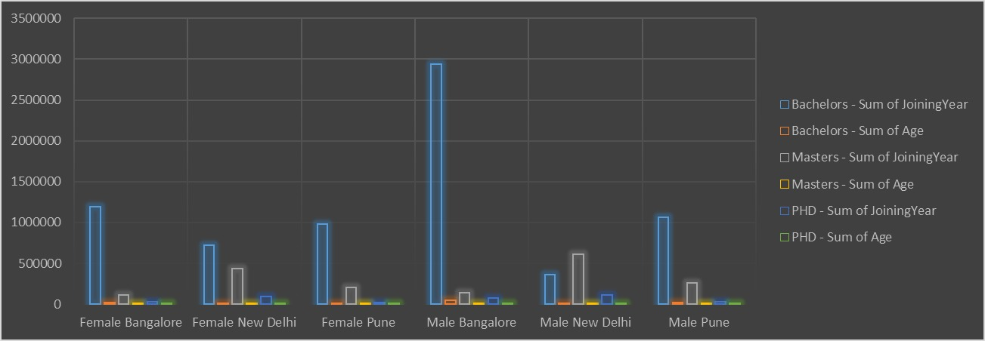
RESULTS
11

Slide 12
conclusion
"In conclusion, our gender analysis has revealed significant insights into the gender dynamics and disparities within [specific area or industry].
The findings highlight the need for intentional efforts to address gender inequalities and empower underrepresented groups.
This gender analysis serves as a crucial step towards a more gender-aware and responsive [organization/industry].
We look forward to continued collaboration and progress towards a more equitable future."

